Slide 1

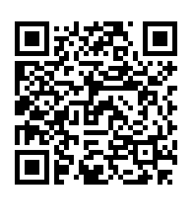
Registration
Notes:
Groups can also delegate roles for each event
-10 days allow for processing, posting and promotion on your side. We can promote but you’ll have to tag the instgram page.
-Link to resource page

Slide 2

Welcome
Committee Event Planning Training
Dami- Communities and Events Coordinator

Slide 3

Overview
Event Planning
Event Procedure
Booking a room
External Speakers
Small and Large Events, What's the difference?
Collaborating with other Student Groups and External
Liberation Months and Potential work with the Students Union
Summary and Q&A

Slide 4

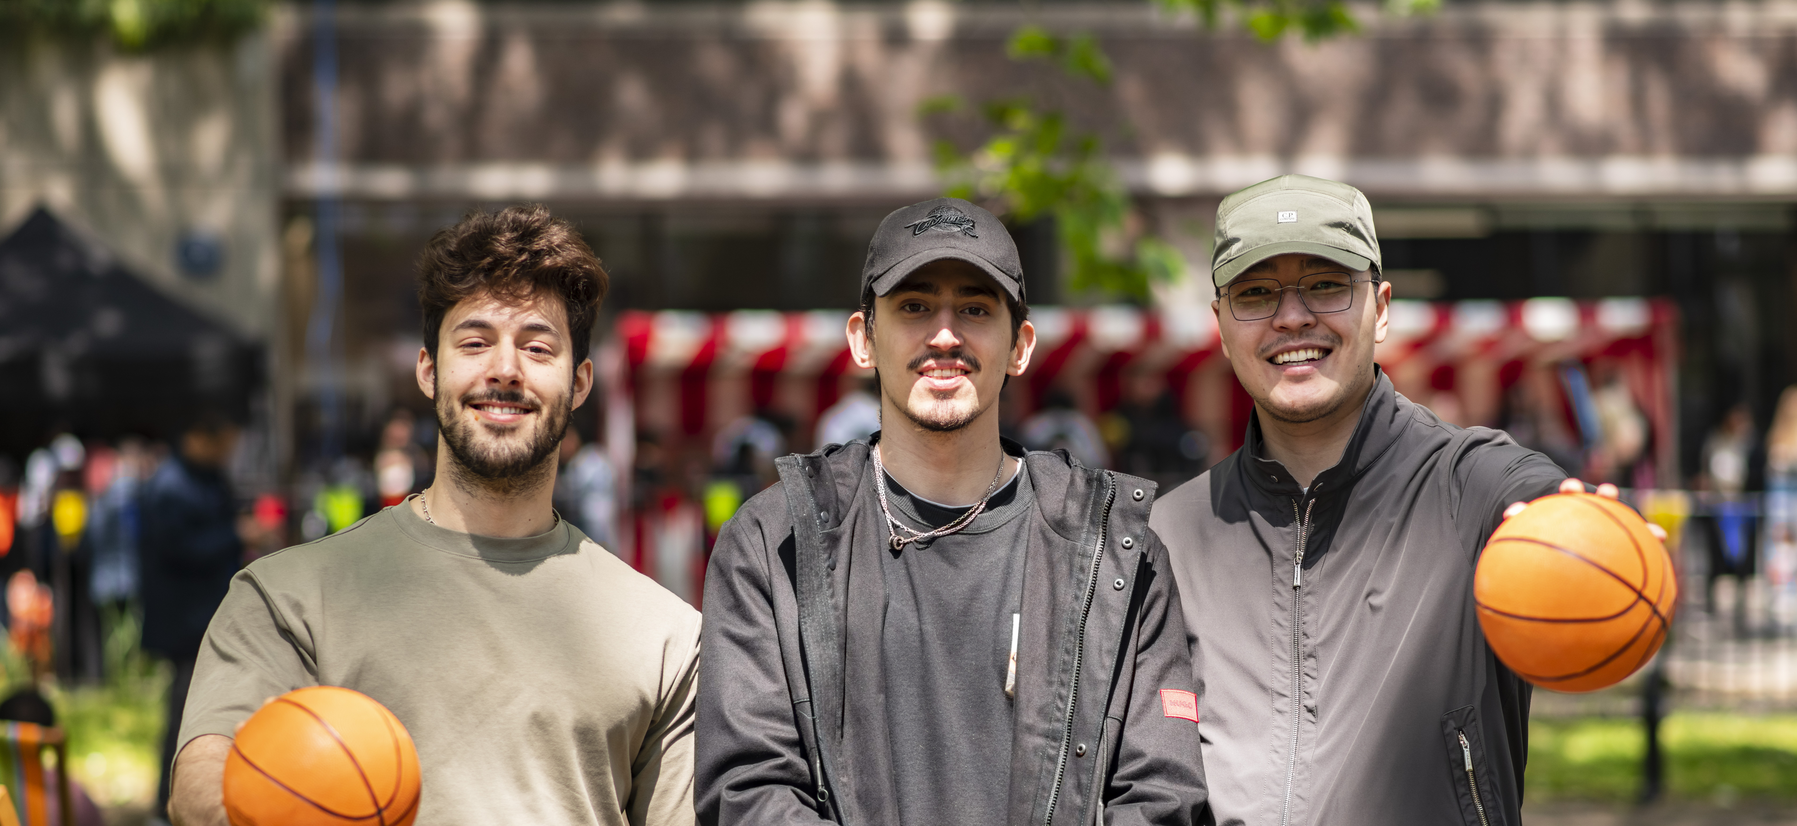
Aims and Objectives
30 minutes plus Q&A and Kahoot Game
To gain an understanding on how to run an event
Events form procedure
To understand the risks involved with event management and what safety measures need to be taken
Budgeting
To understand the Student Union procedures

Slide 5
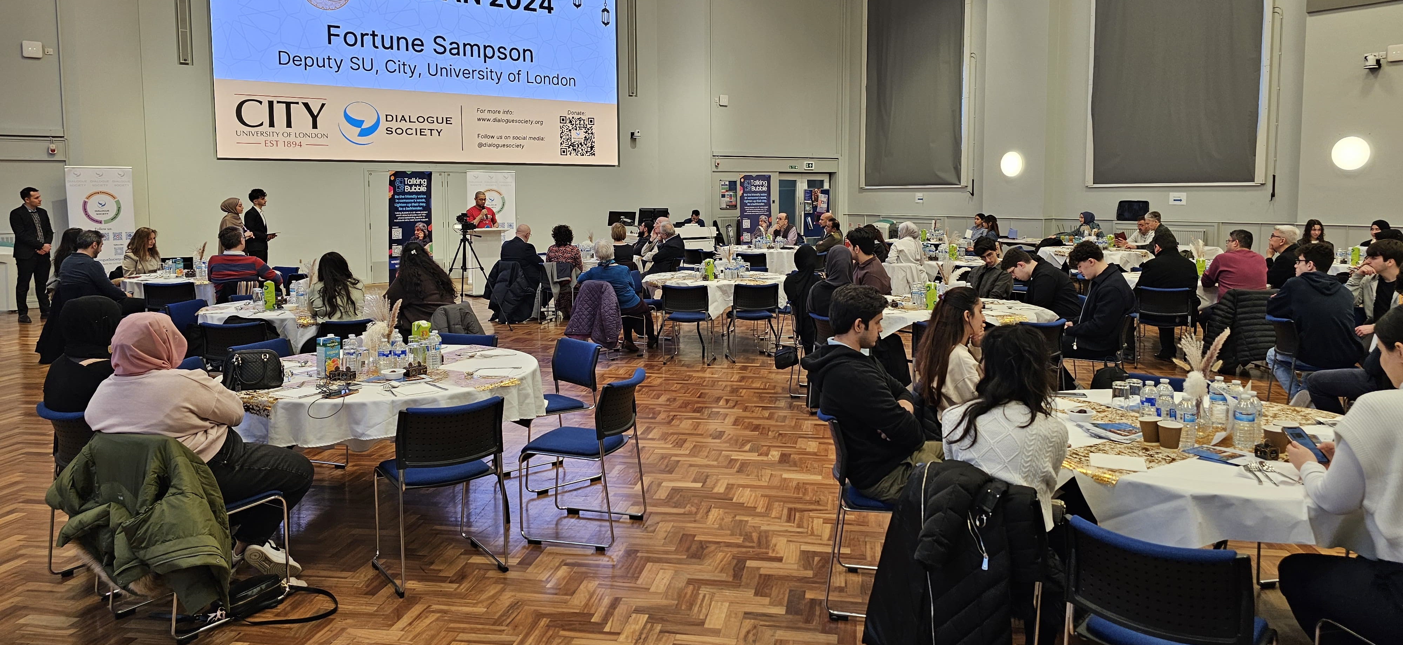
What makes a good event and what are the potential risks?
Notes:
Ask audience this question

Slide 6
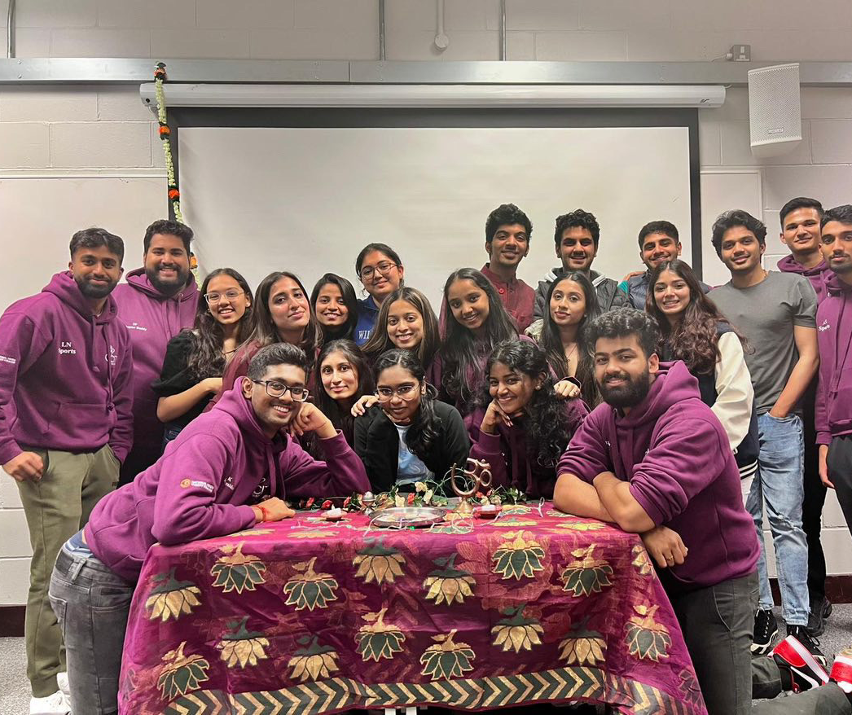
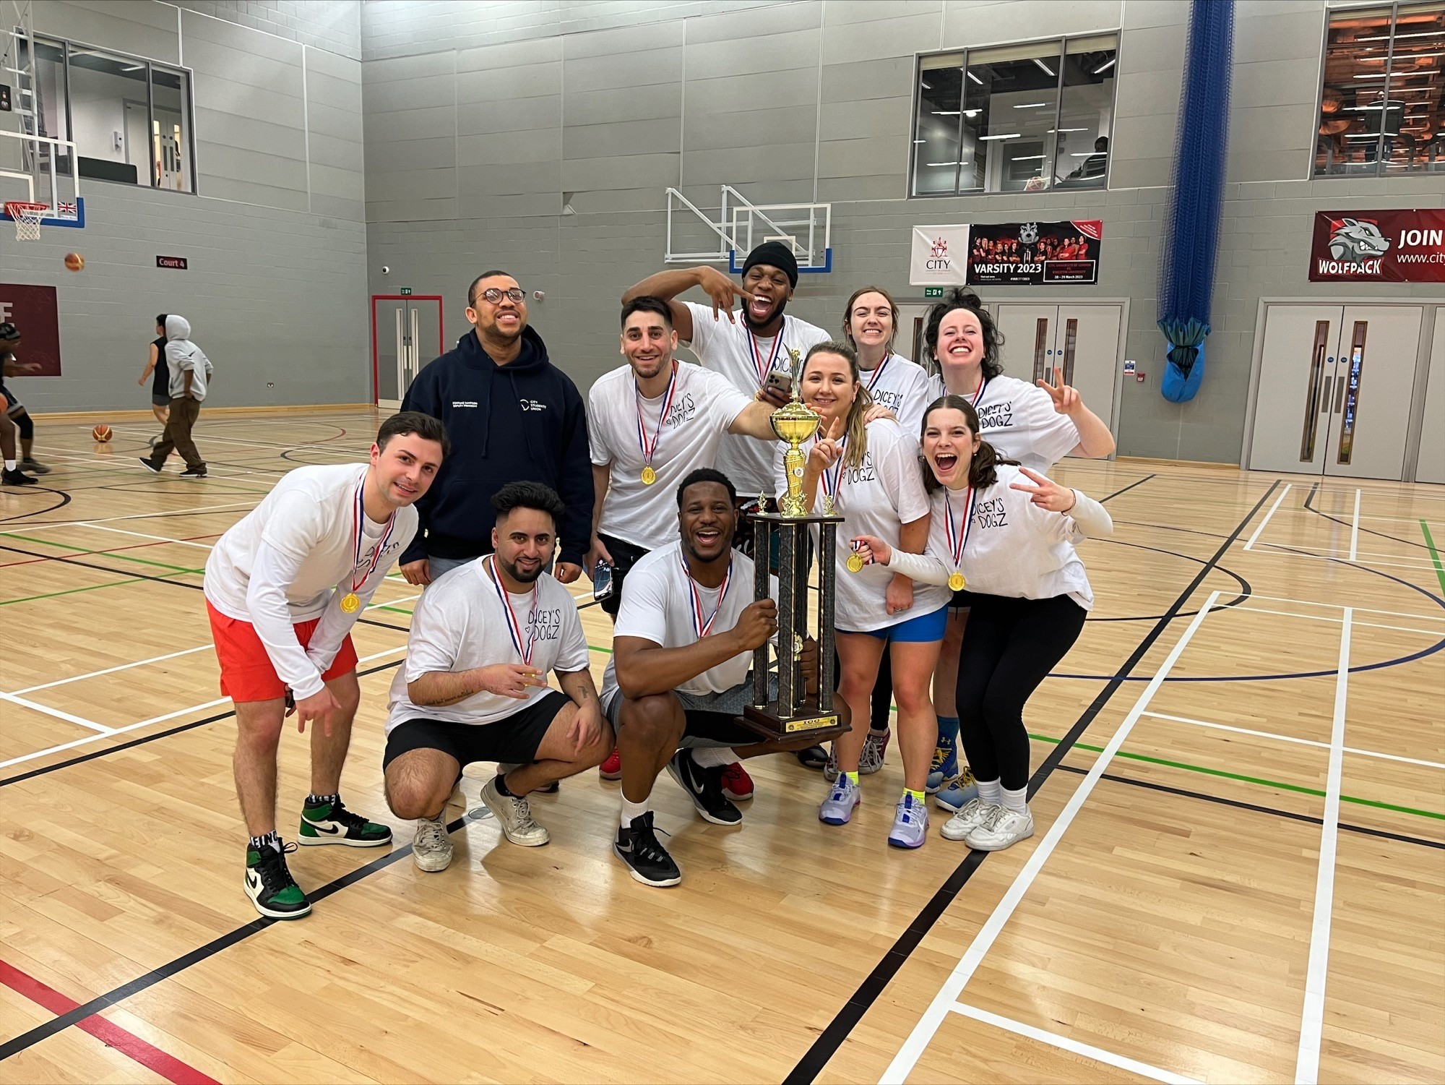
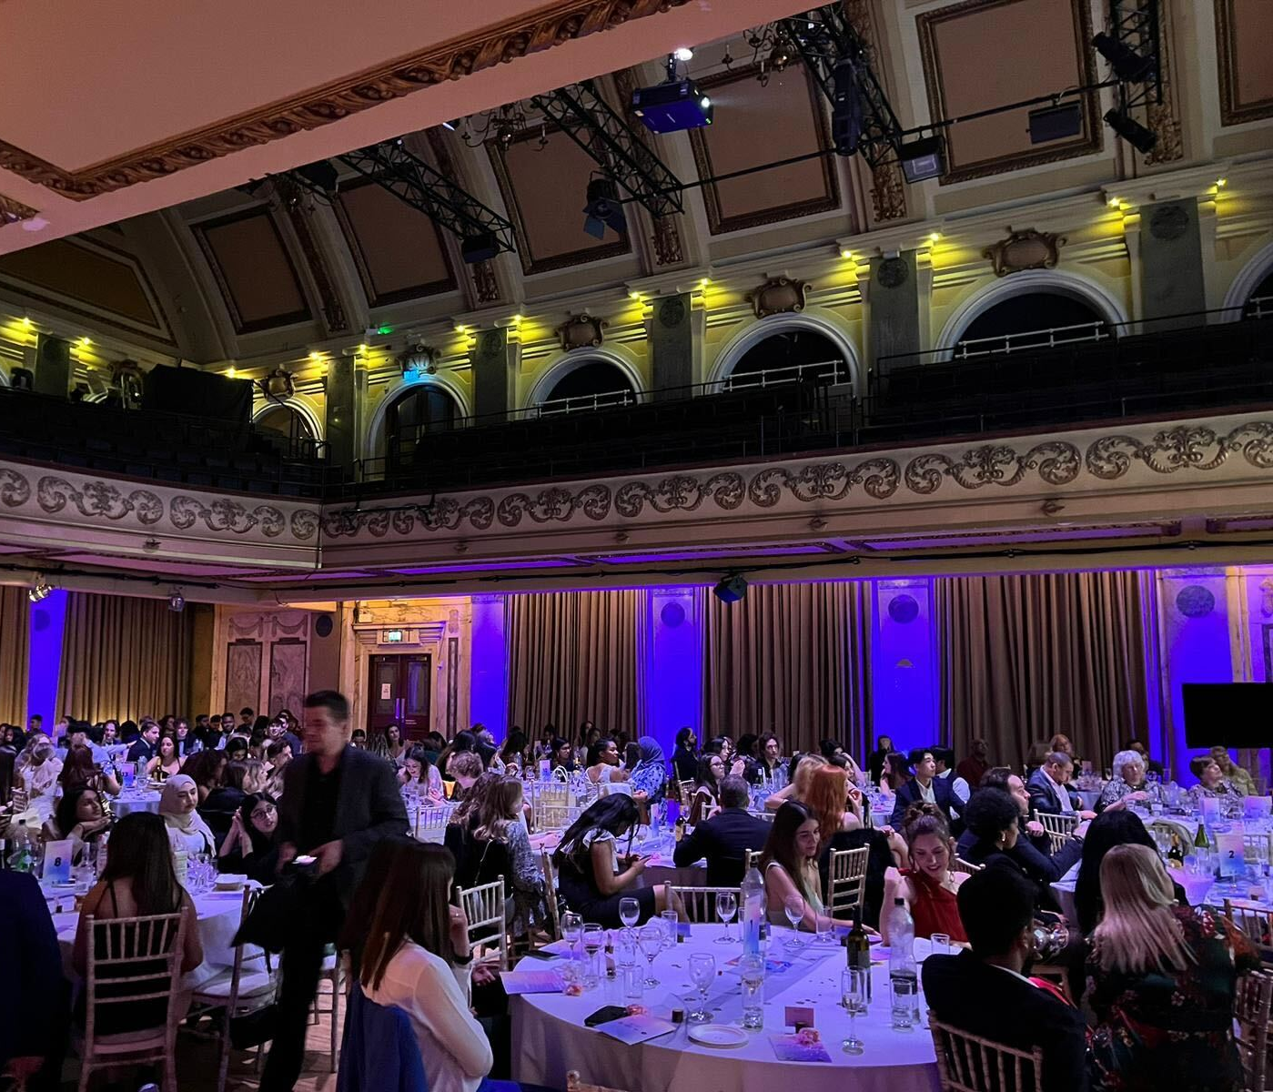
Event Types
Sports Day Events
Meet and Greets
Trips to Amusement Parks and City’s across the country
Nights Out
Games Night
Networking events
External Speakers Events
Notes:
Groups can also delegate roles for each event
-10 days allow for processing, posting and promotion on your side. We can promote but you’ll have to tag the instgram page.
-Link to resource page

Slide 7

Liberation Months
October-April
As part of our EDI aims and objectives at the students union we have an EDI calendar which is aimed at celebrating different cultures and liberation months around the month.
If you’d like to collaborate with the student union on an event, activity or comms campaign to raise awareness for a key calendar month special to you then we’re open to new ideas and campaigns. Email sucommunities@city.ac.uk
Please see examples below for some examples:
October- Black History Month
November- Islamophobia Awareness Month
December- Disability Awareness Month
February- Lunar New Year, LGBT+ History Month
March- International Women's History Month

Slide 8
Collaborating with other student groups
Collaboration with other student groups in City and other universities is allowed (But this must go in the events form)
You'll need to consider about costing ad ticket allocation to both societies.
You’ll need to consider the roles each society is doing, so everyone is helping out
You can chat to the student union about your potential collaboration ideas in your development meetings.

Slide 9
Event Creation- 5 W’s to Consider
Why? Why are you hosting this event? Is it for the right reasons and is the appropriate? Exams approaching? End Of Term? Start time to late?
Who? Who are this event aimed at? Have you considered accessibility needs? Promotion to who on social media?
What? What type of event are you holding? How did this event come become a thought?
Where? Location, is this better suited in a classroom, lecture Theatre or open plan common room? Onsite or Offsite?
When? Is the time chosen suitable for the event? Is your preferred location or venue available? Is changing the date an option?
Notes:
Groups can also delegate roles for each event
-10 days allow for processing, posting and promotion on your side. We can promote but you’ll have to tag the instgram page.
-Link to resource page

Slide 10
Event Creation- Top tips
Accessibility requirements for your guests and whether your event can cater for that
Event Agenda and format. If it’s in the evening can everyone come? Will it finish before 9pm (building closing time)
Event costs and items paid on time, to avoid late event stress
Allow plenty of time to promote your event to your guests.
Make sure your event costs are within your budget (Development funding is available throughout the year)
Development funding can be used by all societies and allows each society to claim up to £1000 throughout the year (only £100 every £500 can be used on food).
Allow enough time for set up and pack down- book rooms that cater for this
Give housekeeping information to guests at the beginning of the event.
Events with alcohol can only take place in certain spaces. Alcohol can be bought externally but comes with a service charge. Alternatively, you can buy alcohol through the university catering (this can be done through the su)
Take care of the space!
Notes:
Groups can also delegate roles for each event
-10 days allow for processing, posting and promotion on your side. We can promote but you’ll have to tag the instgram page.
-Link to resource page

Slide 11
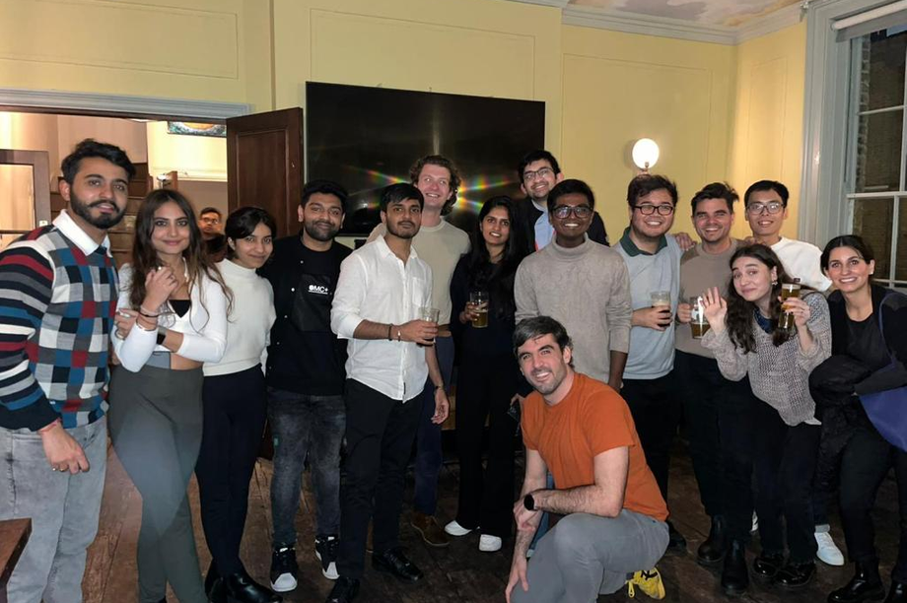
Event Planning
Use the Free time you have to plan events for the year in advance
Delegate which members oversee what events.
Events Forms have to be submitted within 10 days of the event to allow for it to be processed and put on the website. (LINK)
Consider the costs associated with each event before agreeing to any payments
Consider Room Capacity
Consider the pricing of tickets and whether your guests will be able to afford the prices displayed.
Notes:
Groups can also delegate roles for each event
-10 days allow for processing, posting and promotion on your side. We can promote but you’ll have to tag the instgram page.
-Link to resource page

Slide 12

Events Form
Event Forms must be submitted at least 10 working days prior to the event is starting.
Larger Events must be submitted at least 15 working days prior to the event to allow for background checks.
Must include ALL necessary information before your event can be made including date, time, preferred room/location, ticket prices, event information/title etc. (Please make sure to fill it out as much as you can)
Events Form submitted after the time may be rejected.
No Tickets to be sold on external platforms, all the tickets to be sold through the SU website.
Externals are allowed into society events, but you need to state this in event forms.
Catering is allowed into events, but you’ll need to state this in the event as we will need to allocate you a room suitable to have food and drink in.
Events to be covered by annual risk assessment (development meetings)
AV/ IT Requirements
Events Booking Form | City Students' Union (qualtrics.com)
Notes:
Events form link.
Anyone caught bringning externals into events could face their event planning privileges taken away from them) especially if they cause damage to university property.
Alcohol? Food? And drink requests?
Check for any costs
Room rules
Individual risk assessment needed

Slide 13

External Speakers Process
Events with External Speakers must be submitted 3 weeks prior to the event to allow for background checks.
Internal speakers are City university students and staff, whilst External speakers is anyone not associated with City University.
Speakers need the Students Union and the University’s approval and any event found to be breaching this rule will be shut down and your society will face a penalty.
You can’t promote the speaker for your event until they have been approved.
Notes:
What is a larger/high risk event?
The Union defines a larger/high risk event events as any one or more of the following:
Parties/club events
Events with 100+ attendees
Events with a budget over £500
Balls
Trips
Overseas travel
Children attending the event
External Speaker Event

Slide 14
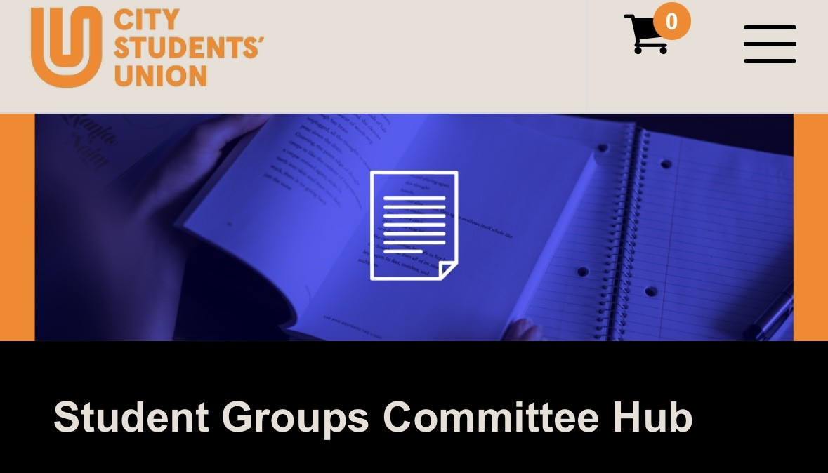
Ticketing
Tickets to be sold through the student union website.
Do not sell tickets on external websites such as Eventbrite or festickets, you’ll end up losing money.
Avoid taking cash in hand.
If you use external websites, you’ll be breaking the union’s finance procedures, and this could result in a strike and restrictions on running future events.
All money made will go into your society subs account
You can ask the student union for information on ticket sales and society balance’s
Tickets can be free.
External tickets can be put on the website but if you’d like city students only, please do let us know in the events form.
You can also set ticket requirements E.G- Society members tickets and non-members tickets.
Notes:
Events form link.
Anyone caught bringning externals into events could face their event planning privileges taken away from them) especially if they cause damage to university property.
Alcohol? Food? And drink requests?
Check for any costs
Room rules
Individual risk assessment needed

Slide 15
Booking a Room
Rooms have to be booked through the student's union.
You can use the student hub to look at the room book timetabling and see the types of rooms you’d like to book and then put this in your events form (subject to availability)
Spaces | Controlled By | Common Uses | Notes
Gateway Group Room (15 capacity) | Students’ Union | Social events External speaker events Meeting Food and drink-based events
Gateway Large Group Room (30 capacity) | Students Union | Movie Nights, Talks, Workshops, Yoga
Pavilion | Facilities | Stalls Social events | Bookings are limited in this space
CityBar, Tait Building | Students' Union Mon, Tues, Thurs, Fri : 8am-11am & 4pm-9pm Wed 8am-11am, 1pm-9pm | Social events Pre-drinks before a night in London Cultural nights, Meet and Greets. | Bar can be opened on request and meeting minimum requirements. Alcohol is hidden.
SU Recording/Podcasting Room | Students’ Union | Podcast/radio recording | Can be used by students, just drop us an email!
Teaching Rooms | Teaching rooms are controlled by Timetabling but must be booked through the student's union via the events form. C3 rooms are controlled by the Students union every Wednesday from 1pm-9pm as teaching has been paused for student society activities. | Social events External speaker events Meetings Meet and Greets, Cultural events | Includes lecture theatres, seminar rooms, computer rooms, etc
Stalls | Students’ Union and Facilities | Political/information campaigns Charitable fundraisers (bake sales, etc) General student group promotion | There are several stall locations across campus with the main one being on the walkway in the university building.
Great Hall | Timetabling | Talks and social events past 6pm | Capacity 400 Often used for exams, so plan in advance!
City Sport | City Sport | Sporting Events Sports Days Inter university sport competitions | Societies will be charged for the use of this space
Notes:
Things to consider:
-Capacity
-Type of event e.g speaker or social. Do you need a speaker?
-Accesibility?
-Costs
-Portering, tables? Chairs?
-Catering?
-Ticket and stewarding
-noise control
-space can be used till 9pm

Slide 16
Risk and Safety – Food Safety
Home- cooked food is not permitted
Clearly label all food being served at your events
Do not sign any catering contracts- the SU needs to sign these
Some lecture/teaching rooms do not allow food- please check with us first.
Catering Options | Requirements
Store-bought food | Make sure allergen information is clear for attendees Keep itemised receipts if you want to be reimbursed
Graysons catering | 2 weeks’ notice
External caterers | The SU will need to see: Level 2 Food and Hygiene Certificate (picture will do) Food Safety Rating (minimum level 4) Public Liability Insurance Risk Assessment form This can all be sent to us via Email

Slide 17
Risk and Safety
1. Annual Risk Assessment
Developed with a member of SU staff in development meetings.
Can cover all small-scale, on campus activity from meet and greets to rehearsals
Only filled out once and covers the whole year – makes your life much easier!
Book your Development Meeting now!
Individual Risk Assessment
Needed for all events that are not covered by the Annual RA e.g. larger-scale events, any event with over 100 people
Required at least 1 week before the event date
Both are vital to ensuring safe, fun and rewarding events!

Slide 18
Risk and Safety – Key Info
Things to remember:
You still need to send us a Risk Assessment for events off-site
Your annual Risk Assessment does not cover:
Events with over 100 people
Events off-campus
Events where we feel the risk has changed significantly
The SU needs to approve all Risk Assessments – just sending one in does not mean everything is confirmed, please wait for confirmation via email
If you do not have an Annual Risk Assessment, you will need to complete an individual one for each event, so it is worth having your Annual RA!

Slide 19
Questions?

Slide 20
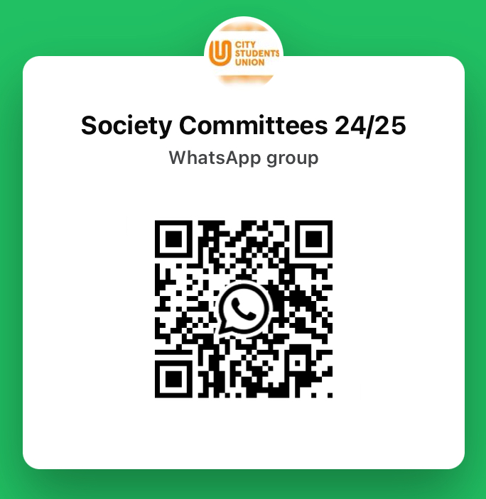
Society Committee Group Chat

Slide 21
Thank you
Contact: Damilola.Dare@city.ac.uk
Sucommunities@city.ac.uk for all society enquiries
Committee Hub- “Get Involved”- “Committee Hub”
Expense Claims
Citystudents.co.uk- Societies- Find your society- Finance requests

