Slide 1

Risk Assessments
(What are they, why do we need them, how do we do them)

Slide 2

Aims of this course
To provide those attending with sufficient knowledge of:-
The legal requirements for risk assessments.
The risk assessment process.
The knowledge required to carry out an assessment and identify appropriate control measures.

Slide 3

We have a legal obligation
Under the Health & Safety at Work Act 1974 and The Management of Health and Safety at Work Regulations 1999 we have several obligations, but in layman's terms we need to ensure that anything we do is as safe as possible for anyone that could come into contact with what we are doing.
We do this by conducting a risk assessment on the task we are conducting.
How do we do a risk assessment I hear you ask

Slide 4
The 5 steps to a Risk Assessment
Identify all significant hazards.
Decide who may be harmed and how.
Evaluate the risk, decide if existing safety precautions are suitable and sufficient or if further control measures need to be implemented to prevent harm.
Record your findings.
Review and revise regularly or when a significant incident or change occurs.

Slide 5
Step 1
Identify all significant hazards.
A ‘HAZARD’ is something with the potential to cause harm.
(this includes articles, substances, machinery, work methods, environment and other aspects).
Here are some examples of Hazards:-
Fire.
Slips, trips, falls.
Working at height.
Working alone.

Slide 6
STEP 1 (Hazards) continued
For any event that you intend to run you ‘must’ do everything foreseeable to identify the possible hazards that could cause harm.
Work your way through what the event entails for example a disco with alcohol and smoke machines may have the same hazards as most events such as Fire and slips, trips and falls but what specific hazards could there be to such an event some examples.
Alcohol= possible aggressive behaviour or Alcohol poisoning.
Smoke machine = potential to trigger breathing issues if someone has an underlying medical condition.

Slide 7


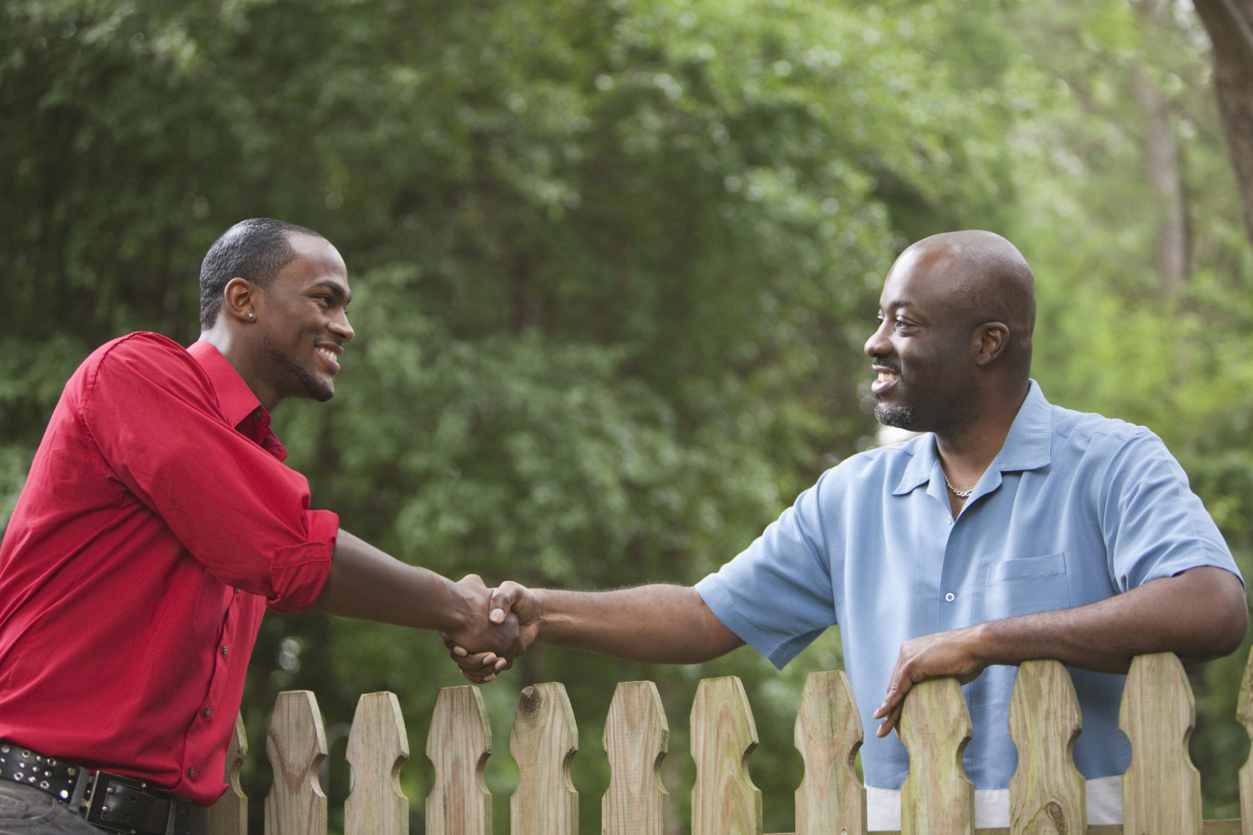

2) Decide who may be harmed and how.
When an event is put on its not just the staff that could be harmed a range of other people could be harmed and we need to identify who.
For example:
Visitors Contractors Neighbours Students

Slide 8
Evaluate the risk
Always start by thinking do we actually need to do this, or do we really need to use this for example:- Bleach is a hazard so if the task is cleaning, can we eliminate the bleach for something else just as good but not as hazardous.
How dangerous is the Hazard for example:- Bleach in a bottle with a child proof lid stored in a cupboard with limited access poses little risk of harm. But the same bottle of bleach open unsupervised on the floor in a room with a small child unsupervised poses a large risk.
A hazards risk depends on how it is used, stored etc… it is key you think about this when writing a risk assessment.

Slide 9
Evaluate the risk (continued)
We must always consider what measures we can put in place to make the task as safe as possible remember:-
E – Eliminate the Hazard (if we can use something equally as good but safer then do so)
R – Reduce the Hazard (if we have a task where we use 50ml of bleach then don’t keep a 500ml bottle in situ).
I – Isolate the hazard from People (only give access to those doing the task and trained to do so safely)
C – Control (if we are working at height cordon off the area control the situation).
P – Provide Personnel Protective Equipment (after we have exhausted all the above measures look at suitable protective equipment to be used when completing the task).
D – Discipline + Training in the above (those conducting the task will need to be trained to do so safely this includes possibly writing a safe systems of work for the person to follow which is a step by step guide and if followed correctly will be the safest way to conduct the task).

Slide 10
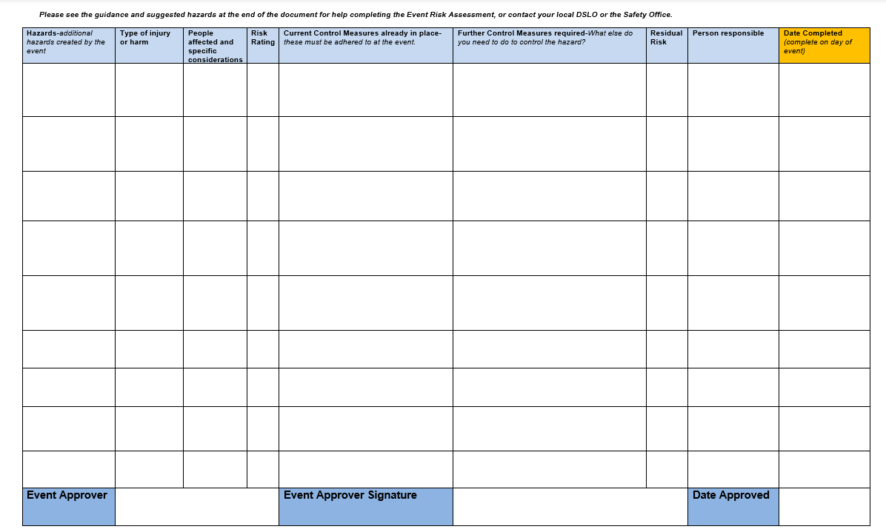
4) Record your findings.
Record your findings on a risk assessment document.
What the hazard is.
What injury could occur.
Who could be harmed
Risk matrix see next slide
Measures already in place
Added measures
Risk matrix see next slide
Person responsible for action
Date action completed.

Slide 11
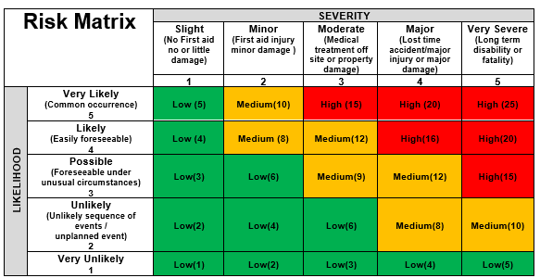
Risk Matrix
When we complete the risk rating and residue risk we should refer to the risk matrix.
We should consider the likelihood of harm occurring x the severity if it were to happen.
Our aim is to ensure that the final residue risk is as low as possible to ensure safety as much as foreseeably possible.

Slide 12
What must be done when the risk assessment is completed.
The results of the assessment and the measures used to reduce the risk must be brought to the attention of all employees and others affected by it.
Safe Systems of Work (SSoW) must be prepared and available at point of use if required.
All control measures put in place must be used and they must be enforced.
Additional control measures must be identified and given appropriate timescales for completion (the risk assessment should be reviewed after additional control measures are in place).

Slide 13
5) Review and revise regularly or when a significant incident or change occurs.
When should a risk assessment be reviewed?
After an accident or near miss.
When there is a change in the task/process.
Change in the workplace.
Change in regulations.
Regularly to ensure the risk assessment is still fit for purpose (most people complete this task annually).

Slide 14

PPE (Personal Protective Equipment)
Somethings to remember in regard to PPE:-
PPE must be suitable for the task and fit the employee correctly.
Must be inspected regularly and maintained.
Must not be used if faulty or damaged and the task should not be conducted until suitable PPE is in place.

Slide 15
Support
When conducting a risk assessment it is always good to do so with all those that are involved in the process for example the manager of the event, the employee who will be conducting the task.
Your student Union Rep, they can assist you with any questions you may have on completing the risk assessment.
The safety team if you have any concerns or questions and require advice please email safetyoffice@city.ac.uk and one of the safety team will be in contact and offer assistance.

Slide 16
Thank you for attending

