Slide 1
Policy Writing Workshop

Slide 2
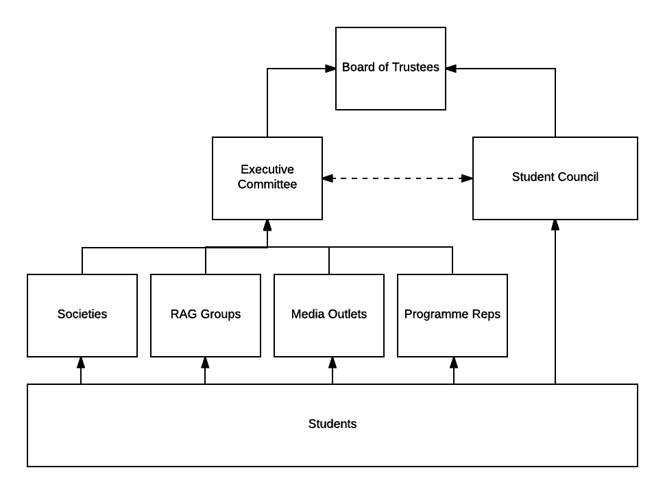
Union Structure

Slide 3
Charitable Objectives
The objects of the Union are the advancement of education of Students at City, University of London for the public benefit by:
2.1 promoting the interests and welfare of Students at City, University of London during their course of study and representing, supporting and advising Students;
2.2 being the recognised representative channel between Students and City, University of London and any other external bodies; and
2.3 providing social, cultural, sporting and recreational activities and forums for discussions and debate for the personal development of its Students.

Slide 4
What is a Motion?
A motion is a proposal that has been put forward by a student (or Executive Officer) about a specific topic
Split into 3 sections; Notes, Believes and Resolves
Notes – Facts about the topic
Believes – Points about the topic that the person/organisation believes contribute to the topic
Resolves – what the policy will do once passed
Must have a proposer and a seconder
Motions become Policy once approved by a Vote!

Slide 5
What is a Motion? (ii)
Policy lasts for 3 years
You can find a full list of Current Policies here: https://www.citystudents.co.uk/student-voice/studentpolicy/

Slide 6
Things to Consider
How does the issue affect City students?
Will people care?
What are you asking the Union to do – is it within our powers?
Is it legal?
Is this something the Union is working on already?
Who will you task to do the resolves?
What resources are you asking for?
We have 3 years to deliver the Policy

Slide 7
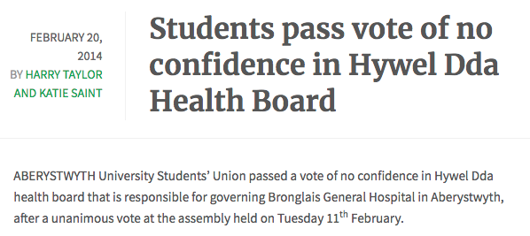
When Motions Get Famous

Slide 8
Good Vs Bad Motions
Meat Free Monday
Sweatshop Labour

Slide 9
Your Turn
In Pairs - Think of something you would like the Union to work on. This could be within your remit, something to lobby the University on or a National Issue.
After a few minutes, present your motion to the rest of the group!

Slide 10
Debates
Arguments ‘FOR’ | Arguments ‘AGAINST’
1st speech FOR the Motion (made the proposer of the motion – 3min)
 | 1st speech AGAINST the Motion (made by anyone – 3min)
2nd speech FOR the Motion (made by the seconder of the motion – 2 min)
 | 2nd speech AGAINST the Motion (made by anyone – 2 min)
The Chair will decide whether to continue the debate. The Chair may decide to take a vote ‘FOR’ or ‘AGAINST’ more speeches (if ‘FOR’ wins there is a repeat of the above process)
Summation (made by the proposer – 2 min)
========== VOTE ==========
Vote ‘FOR’ or ‘AGAINST’ the whole motion (including any amendments) or you can choose to abstain from the vote. If ‘FOR’ gets more than half the votes the motion becomes Union Policy.

Slide 11
Any Questions?

